Slide 1
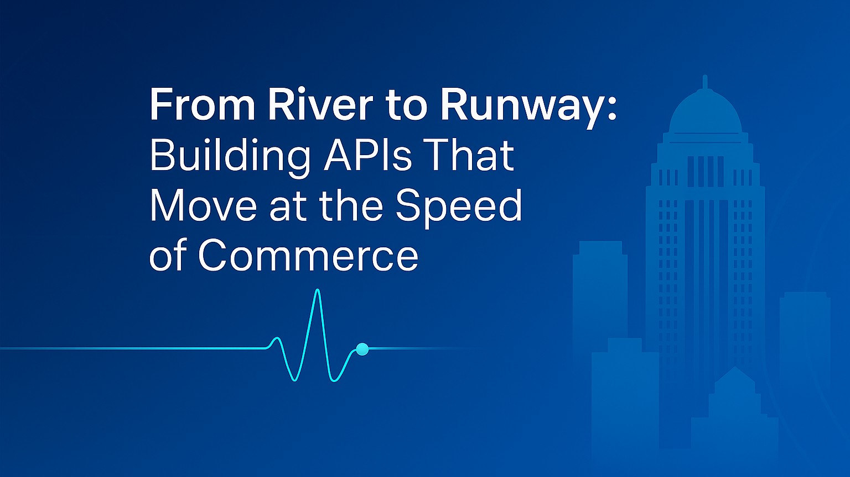
Notes:
Welcome everyone!
Today, we will explore how to design APIs that can handle anything you throw at them — whether that is a sudden traffic spike, a regional outage, or evolving business demands.
Louisville is a city built for movement — a global logistics hub, home to UPS Worldport and countless distribution networks. Its location at the Falls of the Ohio once required goods to be offloaded and rerouted — a challenge turned into infrastructure. Today, it’s optimized for throughput, coordination, and resilience.
By the end of this session, you will walk away with:
A clear blueprint for building APIs that stay online under pressure.
Practical Azure patterns for scaling without overspending.
Proven monitoring and recovery strategies you can implement right away.
Like Louisville’s logistics systems, your APIs should be designed to handle load, reroute intelligently, and keep delivering — even when conditions change.

Slide 2








Agenda
Building Resilient and Scalable APIs in Azure
Intro & Problem Space
Azure Toolset Overview
High Availability & Disaster Recovery
Resilience Strategies
Monitoring & Observability
Live Demo
Blueprint & Wrap Up
Q&A
Notes:
Here is our roadmap for the next xx minutes.
Louisville is a logistics powerhouse — and our agenda is designed like a distribution network. We will start at the hub: the problem space. From there, we will move through each checkpoint — the Azure building blocks, high availability and disaster recovery, and resilience strategies — ensuring every part of the system is covered.
We will track our “shipments” with monitoring and observability, run a live demo to see the flow in action, and finish with a blueprint that ensures smooth delivery every time.
By the end, you will know how to design APIs that keep moving, reroute intelligently, and deliver reliably — just like Louisville’s logistics systems.

Slide 3
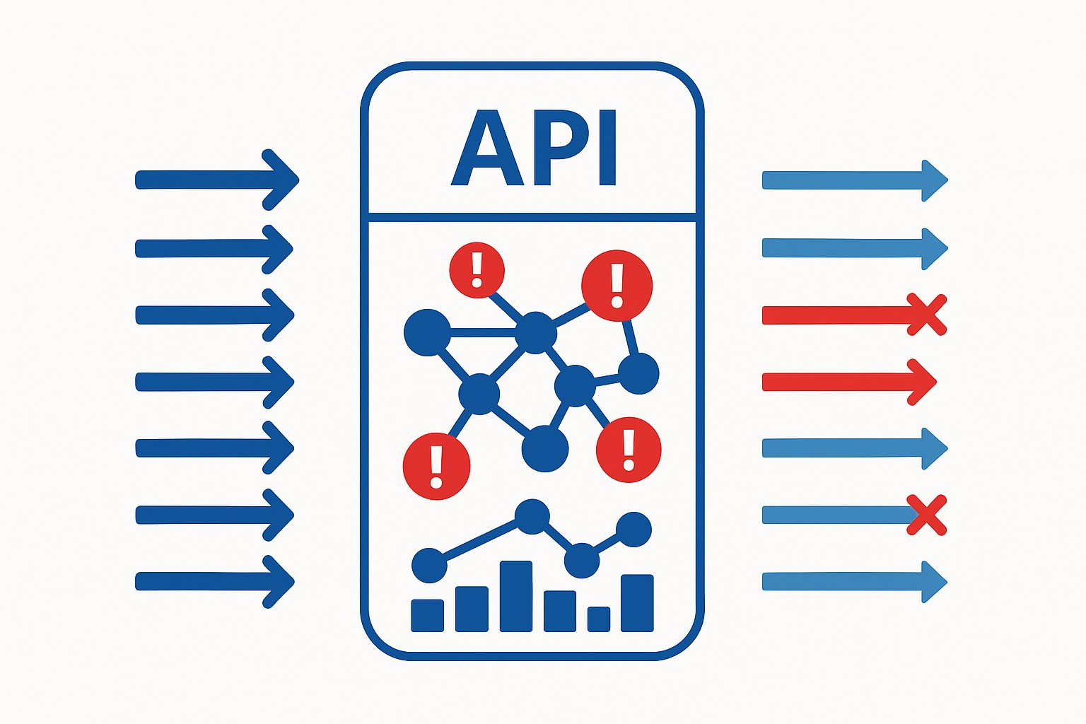
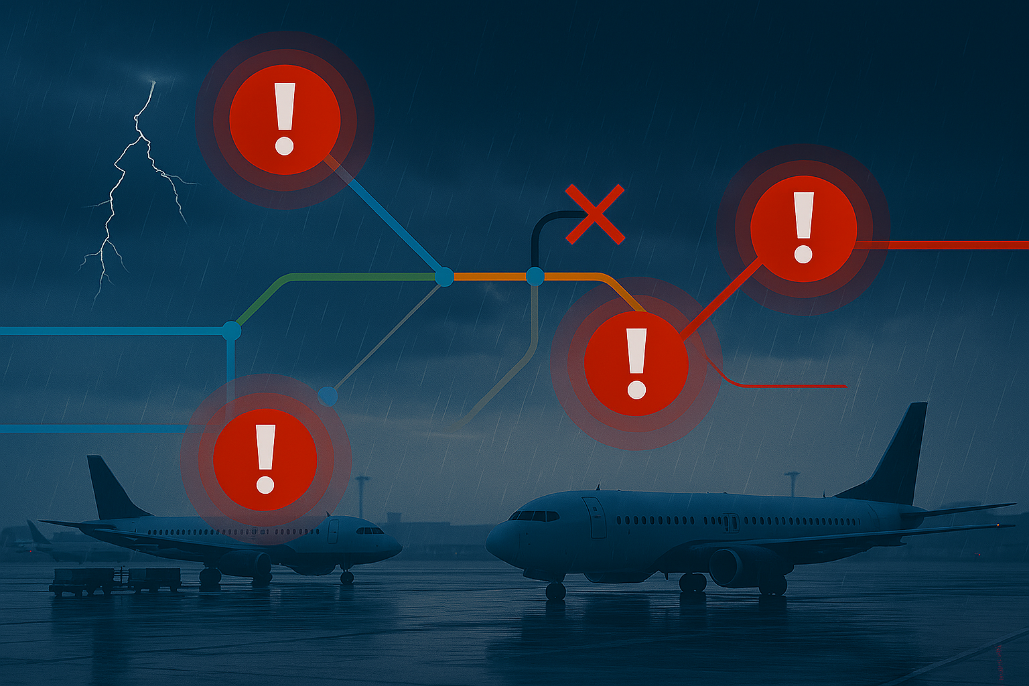
The Resilience Challenge
Building Resilient and Scalable APIs in Azure
Notes:
Louisville is a logistics powerhouse — home to UPS Worldport, where packages from around the globe are stored and sent on their way. But what happens when a storm grounds flights? Or when a critical conveyor belt goes down? The entire network fees it.
Your APIs operate in the same way. They are hubs in a larger delivery chain. A sudden spike in orders, a failed upstream service, or a slow database query can back up the entire system.
In logistics, you cannot just stop the flow — you reroute, prioritize, and keep the most critical shipments moving. In APIs, resilience is defined as retry policies, circuit breakers, and graceful degradation.
The stakes are high. In a world where customers expect next-day delivery or instant API responses, downtime is not an option. The challenge is building systems that can weather the storm and keep delivering.

Slide 4










Resilience Turnaround
From Fragile to Fault-Tolerant: An API Resilience Transformation
Before (Challenges)
After (Results from Azure Patterns & Services)
Legacy Stack
Unplanned Outages
Cascading Failures
Protected Gateway
Multi-Region
Smart Patterns
No visibility
Manual Recovery
Live Metrics
Scales on Demand
Notes:
Let me give you a realistic example.
There is an organization that started with a patchwork of legacy integration systems and a couple of home-grown API gateways. They were fine on a normal day, but when traffic spiked, the cracks showed. Requests piled up, upstream services failed, and without throttling or caching, these failures cascaded.
They had no real-time visibility, so they were always reacting after customers felt the pain. Every failover was manual, expensive in both time and money.
They decided to re-architect with resilience in mind, using the exact patterns and Azure services we will be talking about today. Azure API Management became their consistent front door, enforcing policies, caching responses, and shielding backends. They deployed across multiple regions with Azure Front Door, so it one region had trouble, traffic flowed seamlessly to another. They built retry and circuit breaker logic into both APIM and their service code. They also wired up Azure Monitor and Application Insights to spot trouble before users did.
The result? A platform that now takes traffic surges in stride, shrugs off upstream hiccups, and has cut downtime dramatically — all while delivering a 315% ROI. This is the kind of transformation we are aiming for in this session.

Slide 5
Azure Toolset Overview
Notes:
We have just experienced the reality of API resilience challenges — the surges, dependency failures, cascading slowdowns, and deployment risks.
Here in Louisville, we know something about keeping things moving. As one of the world’s busiest logistics hubs, home to UPS Worldport, the city runs on precision, timing, and the ability to adapt when the unexpected happens. When a storm grounds flights or a conveyor belt goes down, the system doesn’t just stop — it reroutes, reprioritizes, and keeps the most critical shipments moving.
Resilient APIs are not an accident. They are the result of deliberate design choices — choices that give you:
Control at the edge — like a central sorting facility directing every package to the right place.
Elasticity in the middle — like adding extra trucks or crews when a surge of shipments arrives.
Intelligence throughout — like real-time tracking that spots a delay and reroutes it before it becomes a bottleneck.
You can build those capabilities on many platforms — Kubernetes in AKS, App Service Web Apps, even traditional VMs — and the principles will apply to all of them.
For this session, though, we will focus on serverless technologies where possible. Why? Because serverless gives us some of those resilience superpowers right out of the box:
It scales automatically with demand — like opening extra loading bays when a shipment surge hits.
It removes much of the operational overhead so that we can focus on the “delivery plan” — the API logic and resilience patterns — instead of maintaining the “warehouse and runways.”
It aligns cost with usage, so you do not pay for idle trucks sitting in the lot.
Think of it as starting with a logistics network that already has flexible infrastructure and on-demand capacity built in. We will start adding the safety systems, the backup routes, and the monitoring, but the base is already designed to handle stress.
In this next section, we will examine the specific Azure building blocks that give us those capabilities and how they work together to create APIs that survive under pressure and keep delivering, no matter the conditions.

Slide 6

Azure Toolset Overview
Primary Trio
Azure API Management
Traffic Shaping and Throttling
Caching
Policy Enforcement
Backend Shielding
Notes:
Let’s start at the front door of our API platform, Azure API Management, or APIM.
In Louisville terms, APIM is like the central intake and routing system at UPS Worldport. Every package — or request — comes through here first. We scan it, verify it, decide where it’s headed, and control the flow so the rest of the network runs smoothly.
From a resilience perspective, APIM gives us several critical capabilities:
Traffic shaping and throttling: Like pacing the flow of packages onto conveyor belts so no single line gets overwhelmed.
Caching: Serving repeat requests instantly, the way frequently shipped items can move through pre-sorted lanes without re-processing every step.
Policy enforcement: Applying consistent rules for authentication, transformation, and validation, just as Worldport applies uniform scanning and routing standards to every shipment.
Backend shielding: Insulating fragile or high-latency services from the chaos of peak-season surges.
This is where we can implement circuit breakers, retries, and failover routing at the edge — stopping problems before they cascade deeper into the system.
Because APIM is a single, consistent entry point for all APIs, we can roll out resilience patterns once and apply them everywhere—just like a central logistics hub can adjust routing for the entire network in real time.
In short, APIM is our first line of defense and our first opportunity to optimize. It is where we absorb the initial shock of a traffic surge, gracefully handle upstream issues, and keep the rest of the platform stable — just as Louisville's logistics operations keep packages moving, no matter the weather or the volume

Slide 7

Azure Toolset Overview
Primary Trio
Azure API Management
Azure Functions
Elastic Capacity
Scale-to-Zero Efficiency
Event-Driven Triggers
Isolation of Workloads
Notes:
After APIM has managed the flow at the front door, we need a way to handle the work itself when demand changes instantly.
In Louisville terms, Azure Functions is like the extra cargo plans that fly in when a surge of packages hits UPS Worldport — and then stand down when the rush is over.
From a resilience perspective, Functions gives us:
Elastic Capacity — like adding more aircraft to clear a backed-up loading dock.
Scale-to-zero efficiency — no idle aircraft burning fuel when there is nothing to move.
Event-driven triggers — responding to shipment arrivals instantly, without constant idling.
Isolation of workloads — each crew works its own route, so one delay doesn’t stall the whole network.
It’s our on-demand workforce — always ready to roll, never idle, and able to respond instantly when the call comes.

Slide 8

Azure Toolset Overview
Primary Trio
Azure API Management
Azure Functions
Azure Container Apps
Granular Scaling
Multiple Scale Triggers
Revisions and Blue-Green Deployments
Service-to-Service Communication
Notes:
Once APIM has directed traffic and Function has handled the quick, on-demand jobs, we need a way to run core services that operate continuously but can flex with demand.
In Louisville terms, Azure Container Apps is like the main distribution routes from UPS Worldport — they run every day, but can add more trucks or flights when package volume spikes, and reroute shipments when weather or congestion hits.
From a resilience perspective, Container Apps gives us:
Granular scaling — like adding or removing trucks based on shipment volume
Multiple scale triggers — responding to real-time package counts, not just a fixed schedule.
Revisions and blue-green deployments — like testing a new delivery route on one lane before applying it across the network.
Service-to-service communication — secure, internal “handoffs” between hubs without sending shipments through public channels.
It is our flexible backbone — always running, but able to adapt instantly when the network’s needs change.

Slide 9






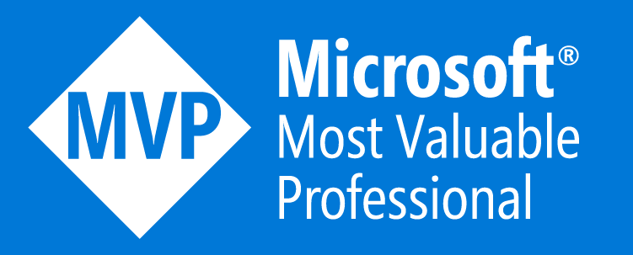
Who is Chad Green?
chadgreen@chadgreen.com
TaleLearnCode
ChadGreen.com
ChadGreen & TaleLearnCode
ChadwickEGreen

